Slide 1

Data Scientist
Salaries
in Europe:
Key Factors
Amaia Jordán
12.11.2024

Slide 2

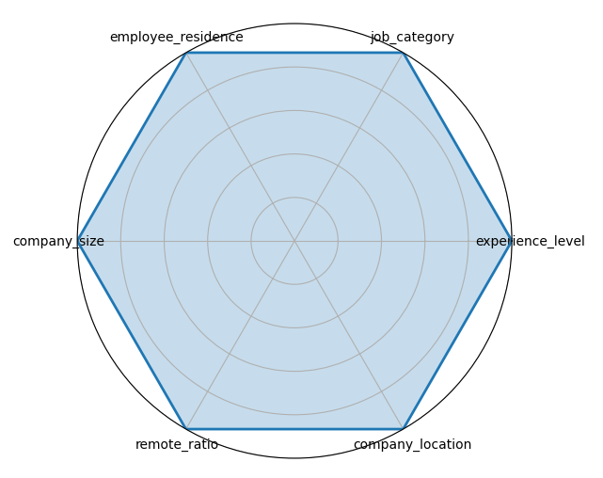




Key Salary Influencers
Residence Country
Northern Europe Eastern Europe Great Britain
Southern Europe Western Europe
Job Category
Data Analyst Data Architect / Engineer
Data Scientist Data Manager
Remote Work Ratio
On - site work Hybrid Remote
Experience Level
Junior Senior
Mid-Level Executive
Company Location

Slide 3
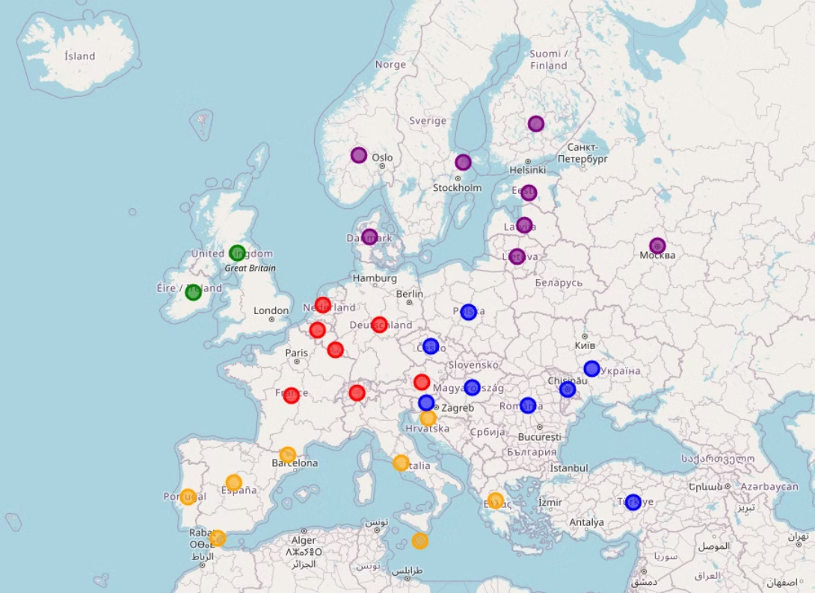
Regions of
Europe
Northern Europe
Eastern Europe
Southern Europe
Western Europe
Great Britain

Slide 4
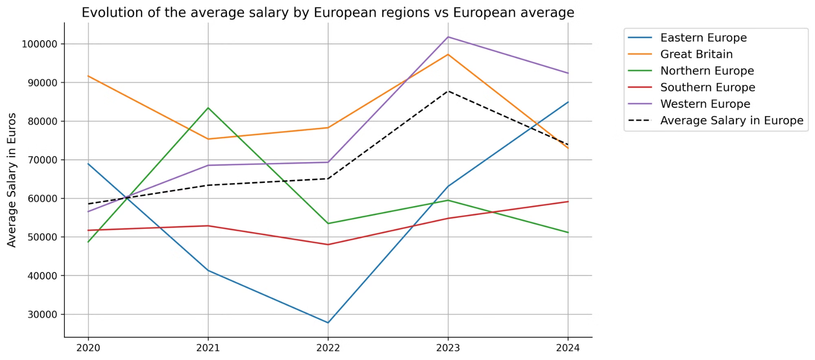
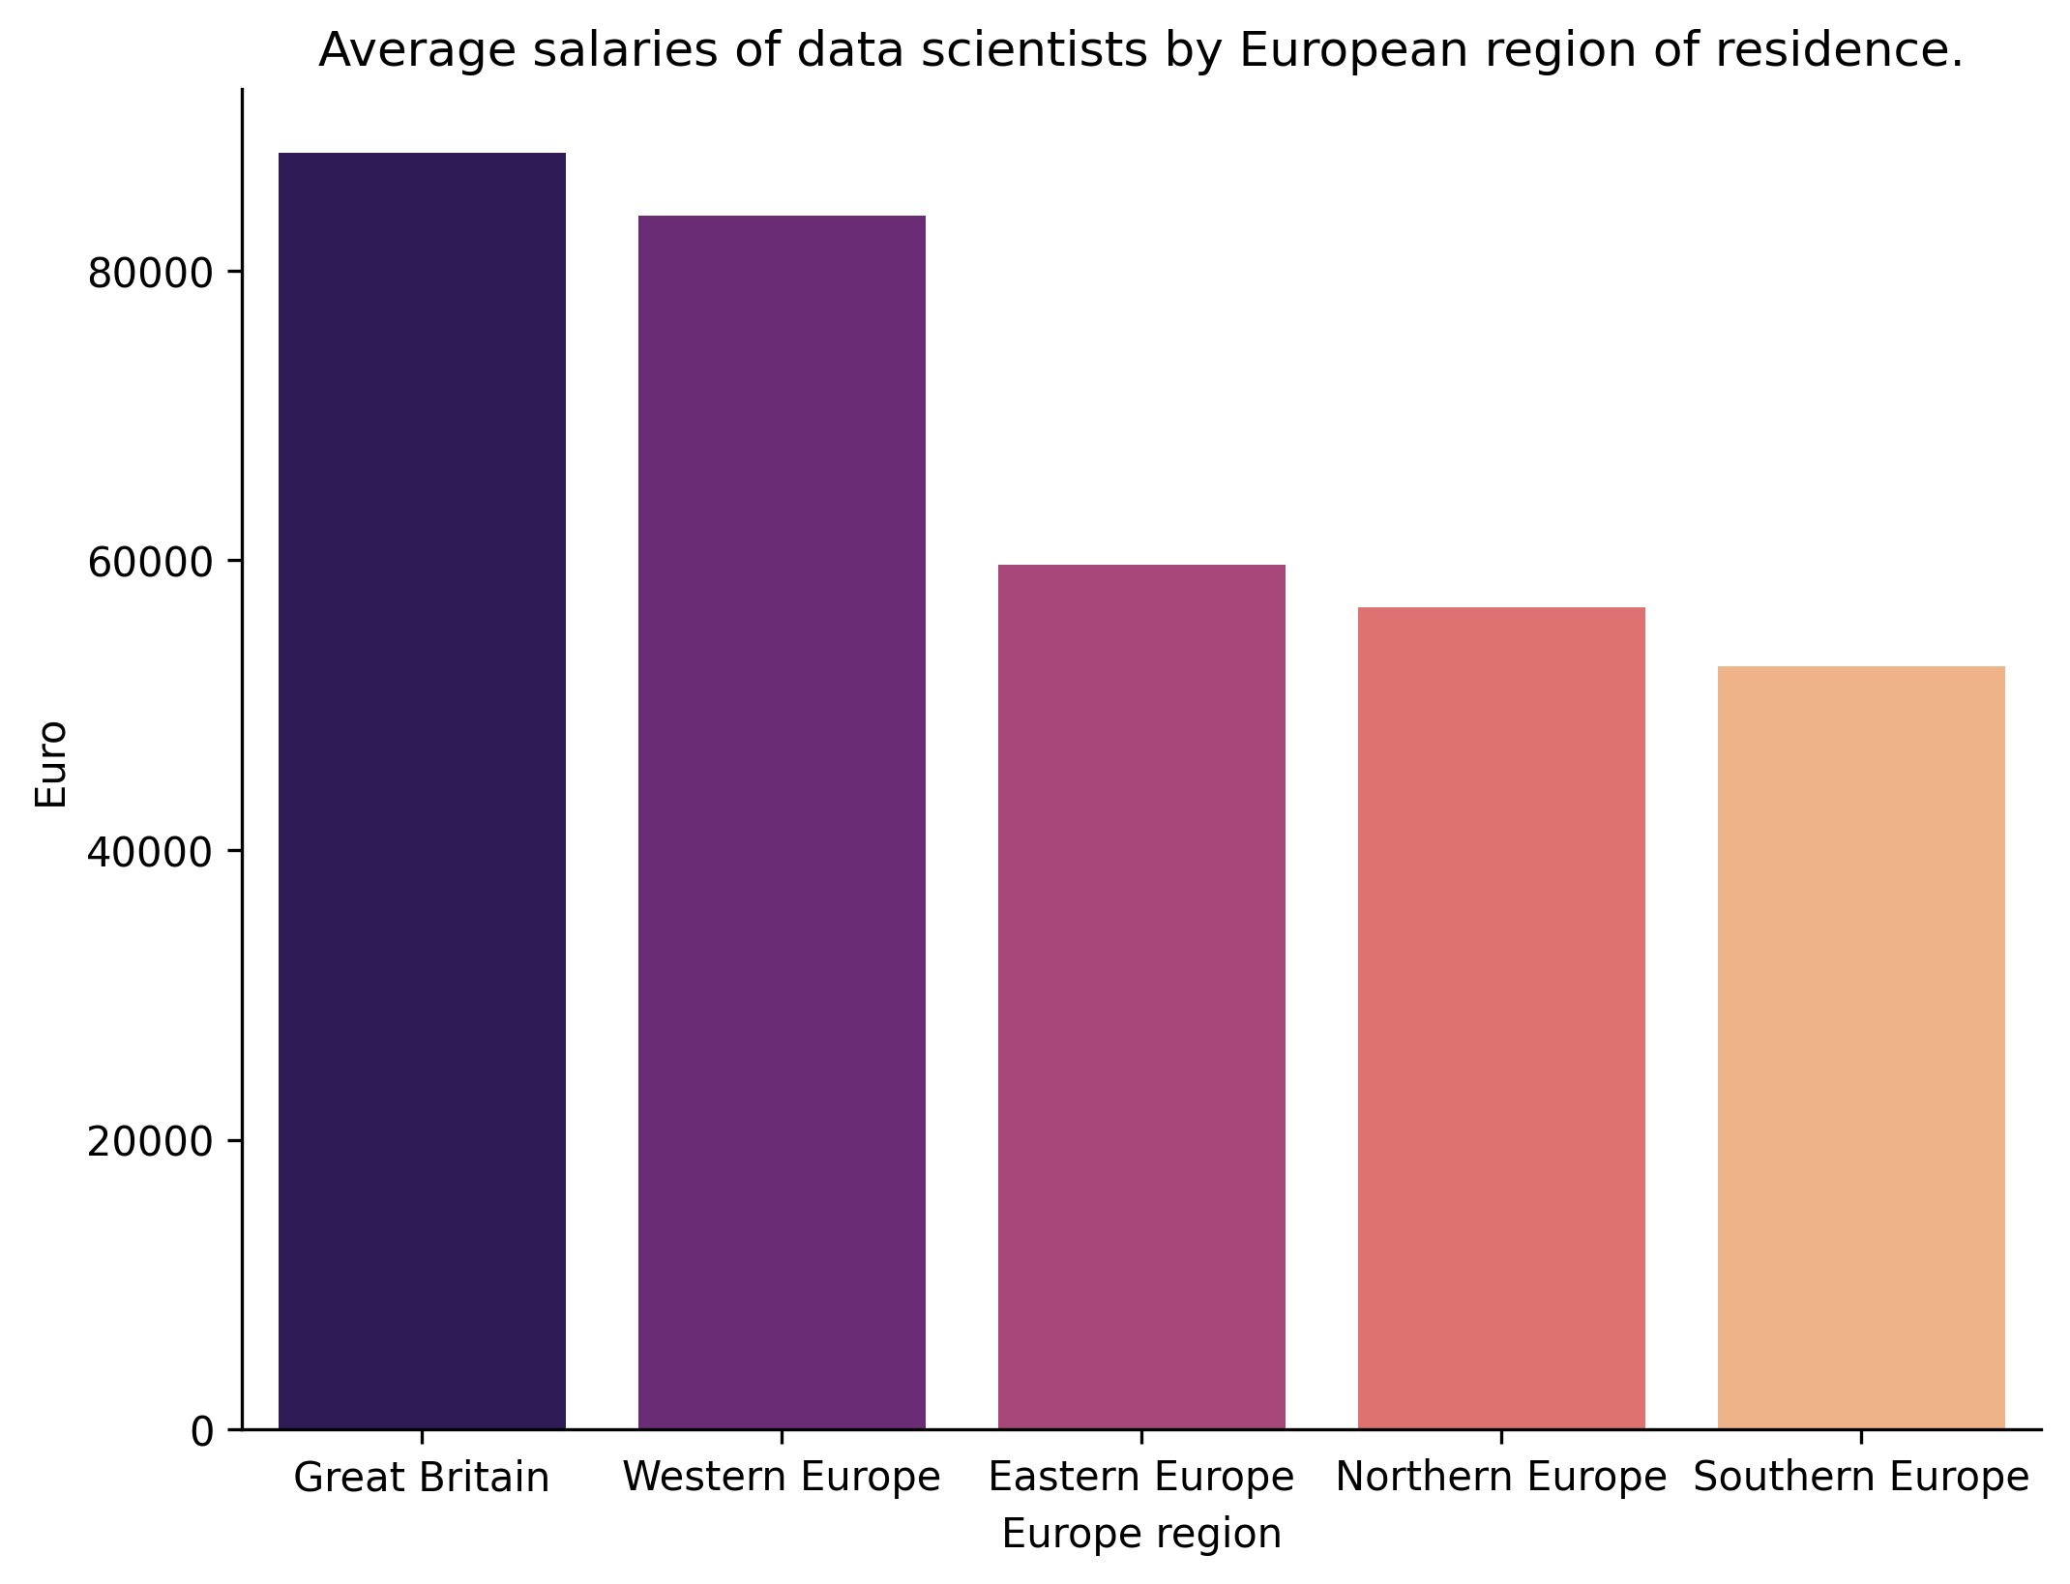

Slide 5
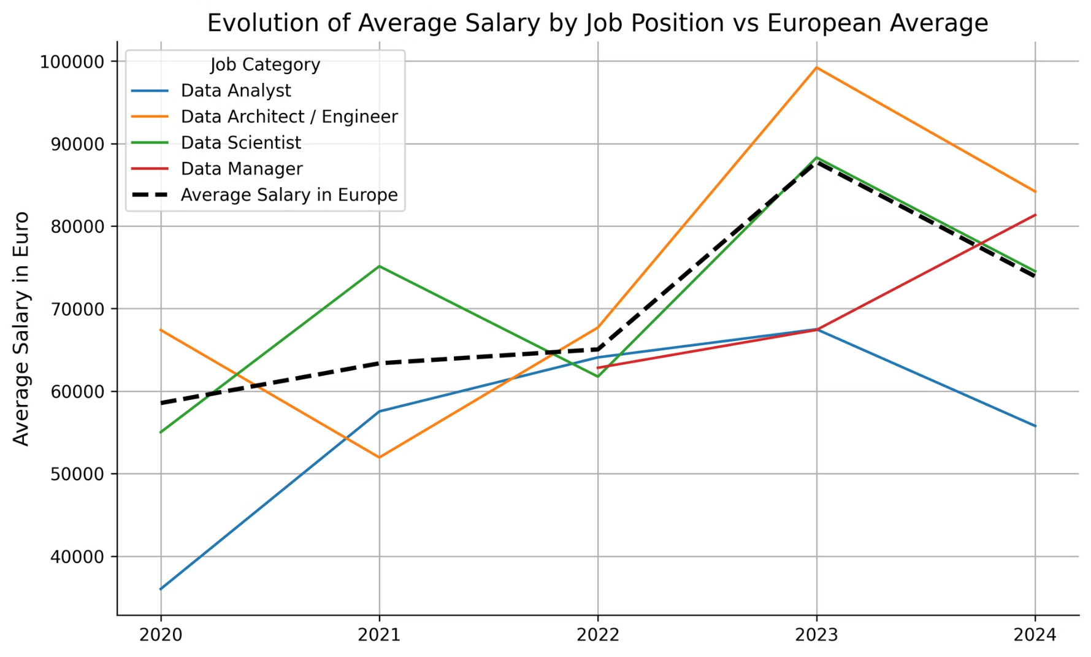

Slide 6
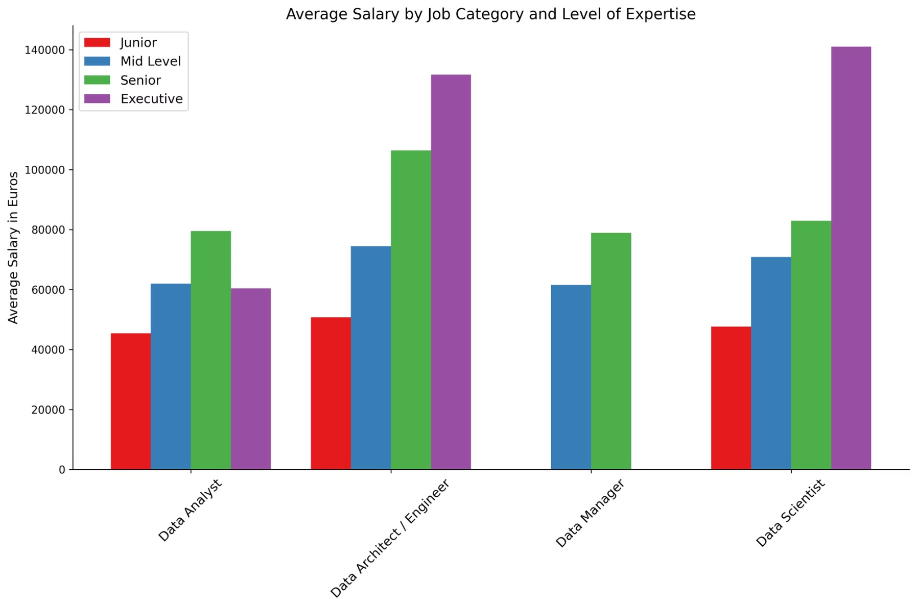

Slide 7
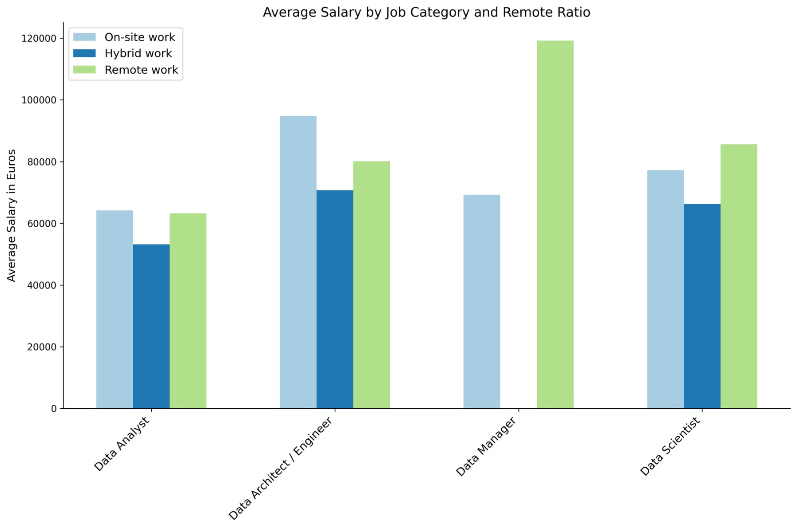

Slide 8
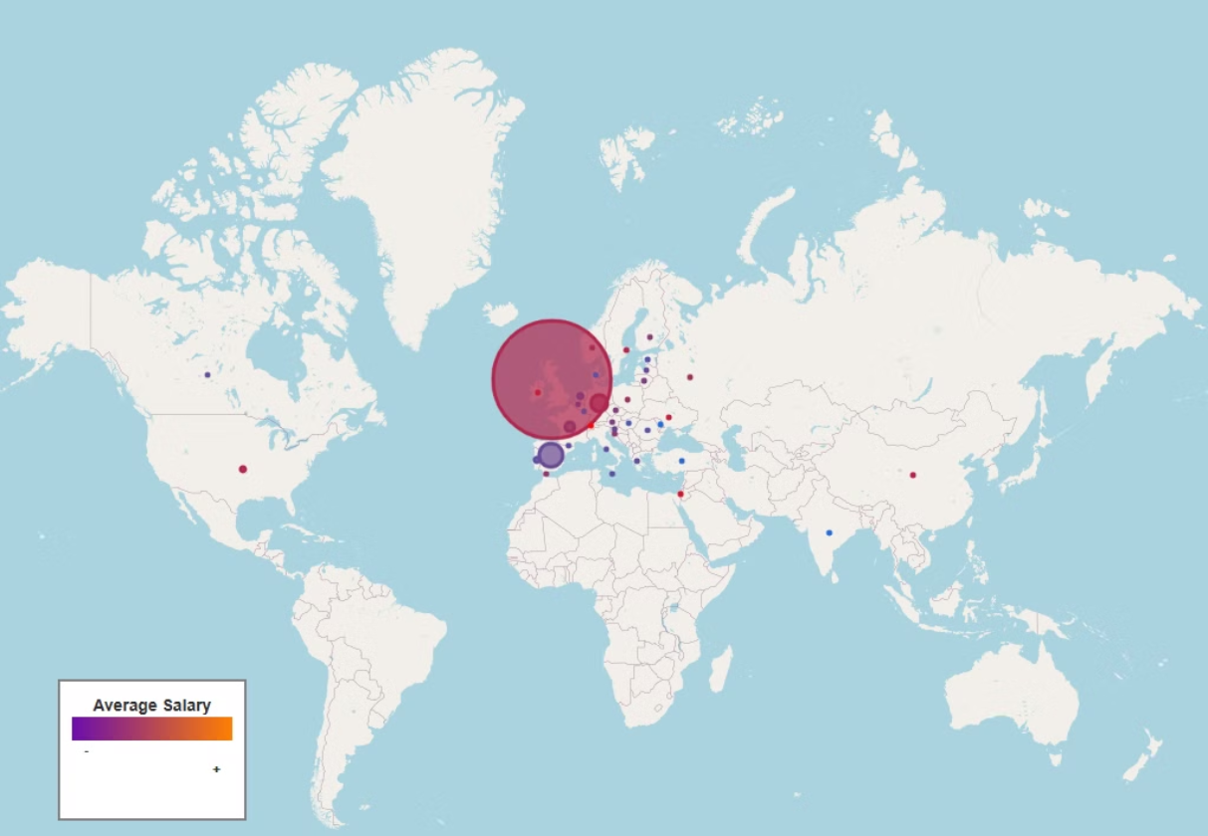
Where are the companies mainly located?

Slide 9
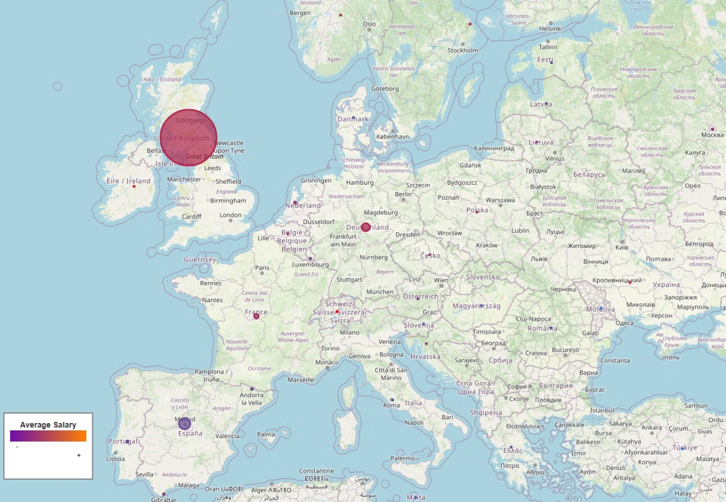
€
Avg Salary in Europe
64.485,50 € / year
1
United Kingdom
54%
87.800 € / year
2
Spain
10.7%
52.272 € / year
3
Germany
7.8%
86,589.09 € / year

Slide 10
QUIZ
A
B
C
D
JUNIOR
EXECUTIVE
MID-LEVEL
SENIOR
DATA ANALYST
DATA MANAGER
DATA SCIENTIST
DATA ARCHITECT
SPANISH
SWISS
START-UP
POLISH
HYBRID
ON-SITE WORK
REMOTE
REMOTE
COMPANY BASED IN SPAIN
MULTINATIONAL COMPANY BASED IN EEUU
COMPANY BASED IN UK
COMPANY BASED IN GERMANY

Slide 11
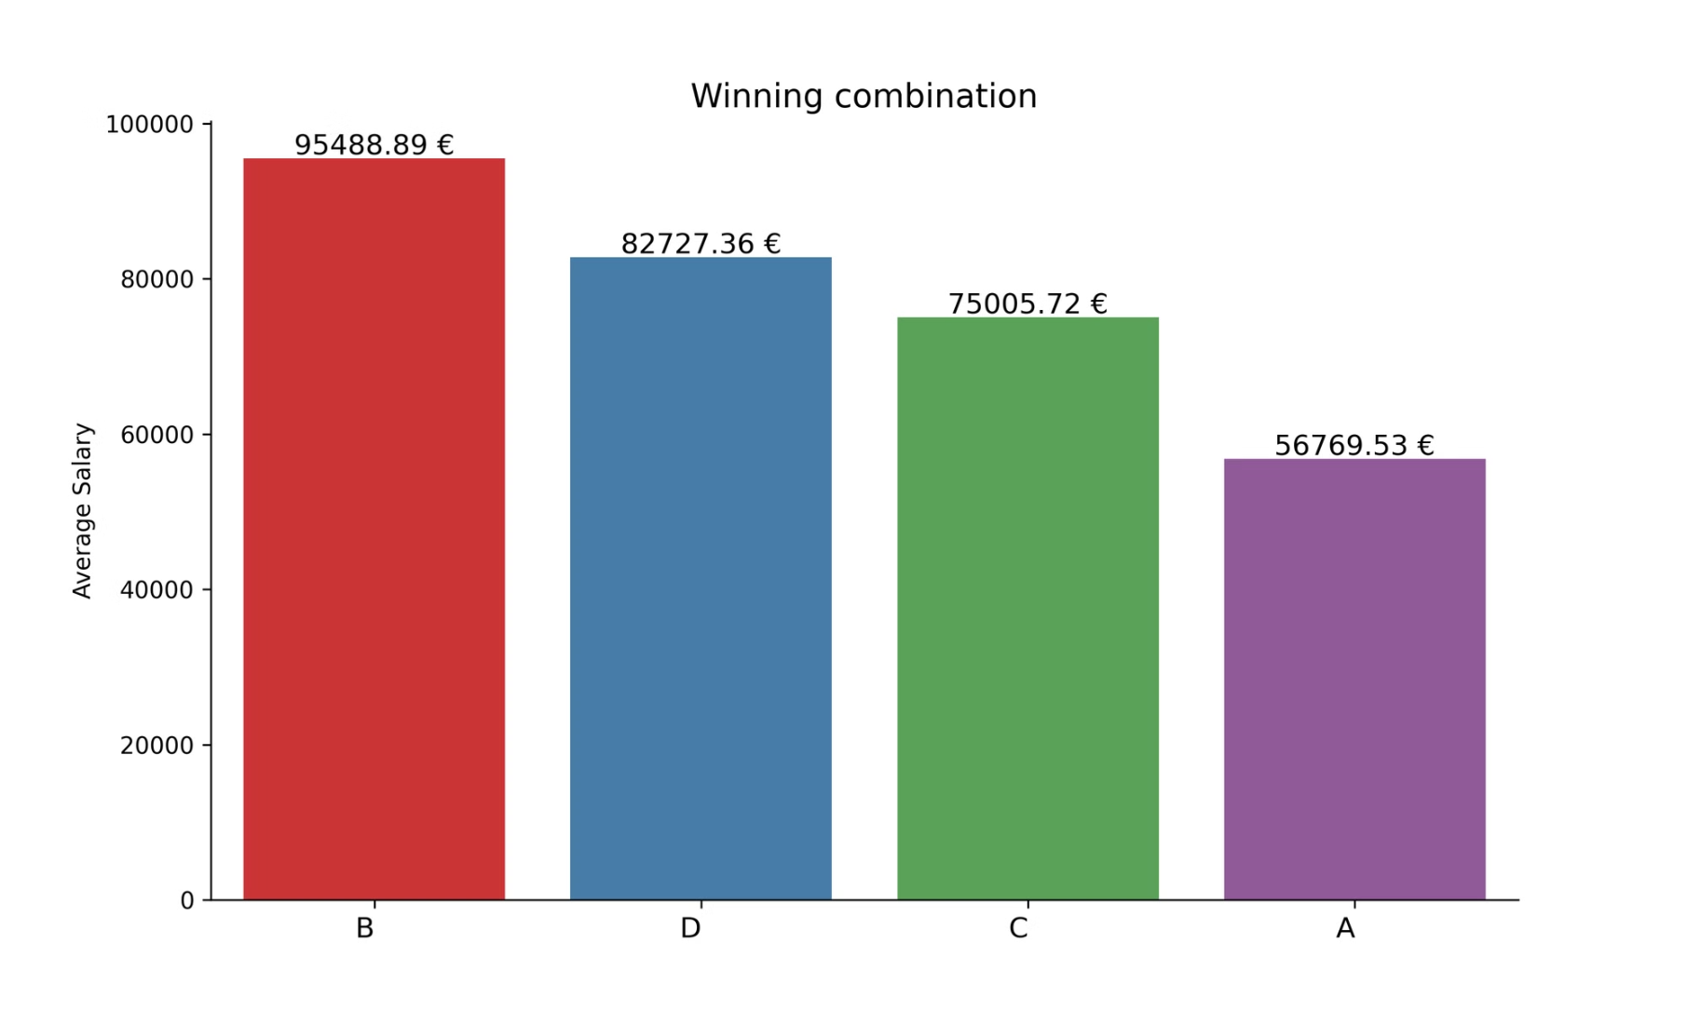
B

Slide 12


